Slide 1
Problem Statement Protecting User Password Keys at Rest (on the Disk)

Slide 2
Unique Idea Brief (Solution) Implementing strong encryption techniques and security best practices to safeguard password keys at rest. This includes using advanced encryption standards and key management strategies to ensure that even if the disk is compromised, the password keys remain protected.

Slide 3
Features Offered Advanced Encryption Standards (AES): Employing AES with strong key sizes (e.g., AES-256) for encrypting password keys. Key Management: Implementing robust key management practices, such as using hardware security modules (HSMs) or secure key vaults to store and manage encryption keys. Access Controls: Setting strict access controls and permissions to limit who can access the encrypted password keys. Auditing and Monitoring: Monitoring access and auditing activities related to the password key storage to detect any unauthorized access attempts.

Slide 4
Process flow Encryption: Encrypting the password keys using AES before storing them on disk. Key Management: Securely storing and managing encryption keys separately from the encrypted data. Access Control: Implementing strict access controls to restrict access to authorized personnel or systems only. Auditing: Regularly auditing access logs and monitoring for any suspicious activities related to the password key storage.

Slide 5
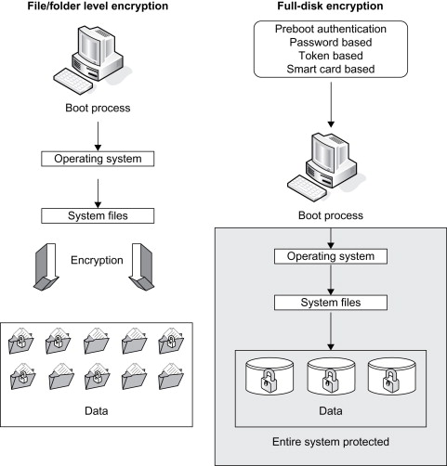
Architecture Diagram

Slide 6
Technologies used Programming Language: Python: Used for developing the application logic and encryption functionalities due to its versatility and robust library support. Encryption Libraries: cryptography: A Python library that provides cryptographic recipes and primitives to encrypt password keys securely. PyCryptodome: Another popular library offering cryptographic functionalities such as AES encryption.

Slide 7
Conclusion It requires a combination of strong encryption, key management, tight controls, and comprehensive auditing to ensure users' password keys are secure when not in use. Thanks to these measures, it is not possible for organizations to ensure the confidentiality of user credentials stored on optical devices and to reduce the risk of access disk storage is safe even if stolen.

